Slide 1
Beat Poets vs. Rocket Scientists: Finding Commonality at an Engineering School
Dr. Natalie M. Dorfeld
Florida Institute of Technology

Slide 2
Description
Too often, artists and engineers are placed into boxes. At FlT, we literally have separate buildings, coding, languages, and tutoring centers.
With the proposal of a new Writing Center in the heart of campus, we are attempting to bridge that gap by creating a welcoming place that caters to the dreamers and pragmatics.
This presentation will examine the joys and frustrations of the current undertaking.

Slide 3
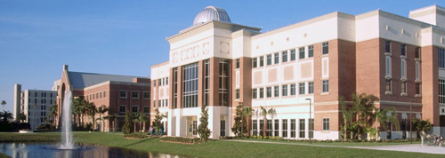
Florida Institute of Technology
Melbourne, Florida (20 miles south of Cocoa Beach)
Roughly 6,500 students
Known for Engineering, Aviation, and Marine Biology
Ratio – 70% male / 30% female
International – 36%
Source: “Rankings & Accolades”

Slide 4
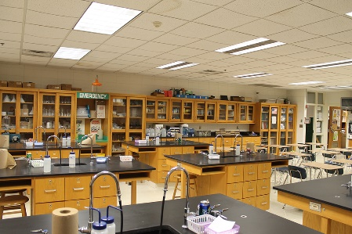
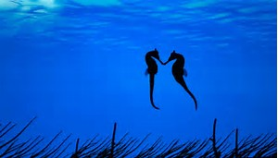
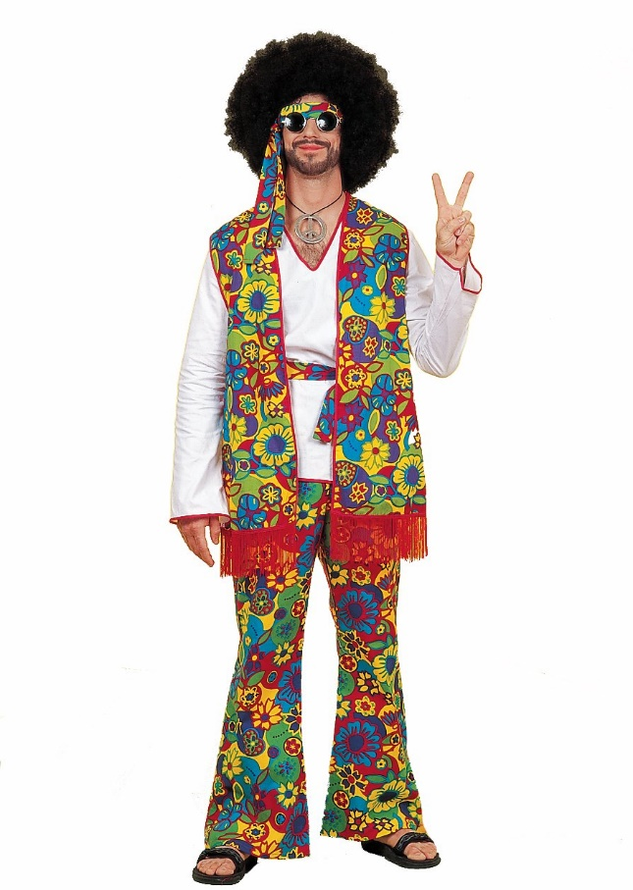

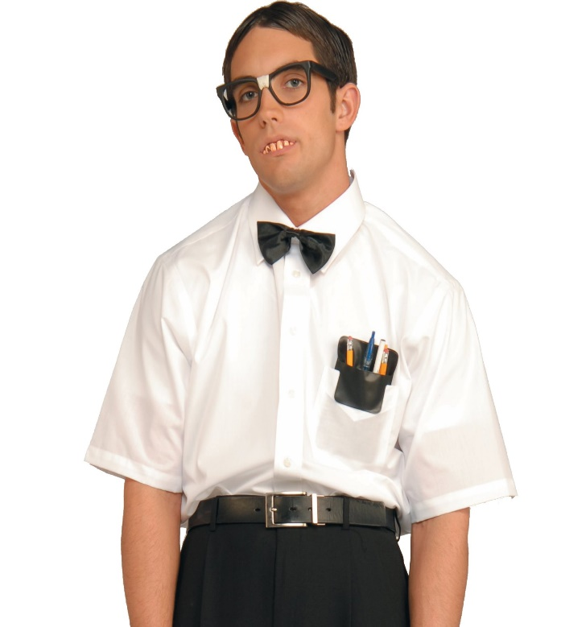
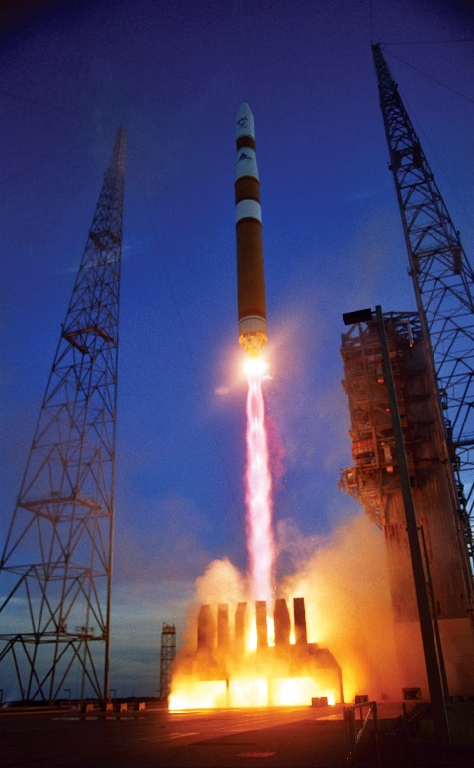

Stereotypes

Slide 5
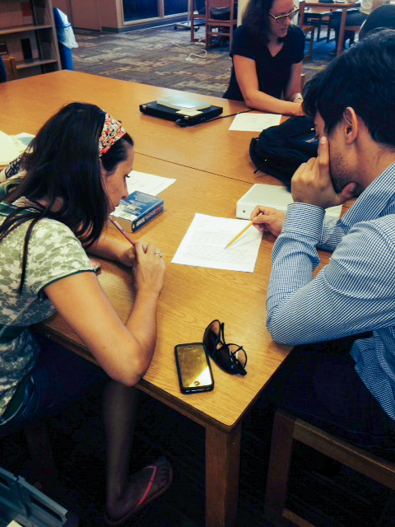
Preliminary Issues
No main Writing Center – just the Academic Success Center.
No physical space except for the library.
Funding? Limited.
Volunteer based, which is spotty at best.
Everyone wants something different.
All of these issues are trying.

Slide 6
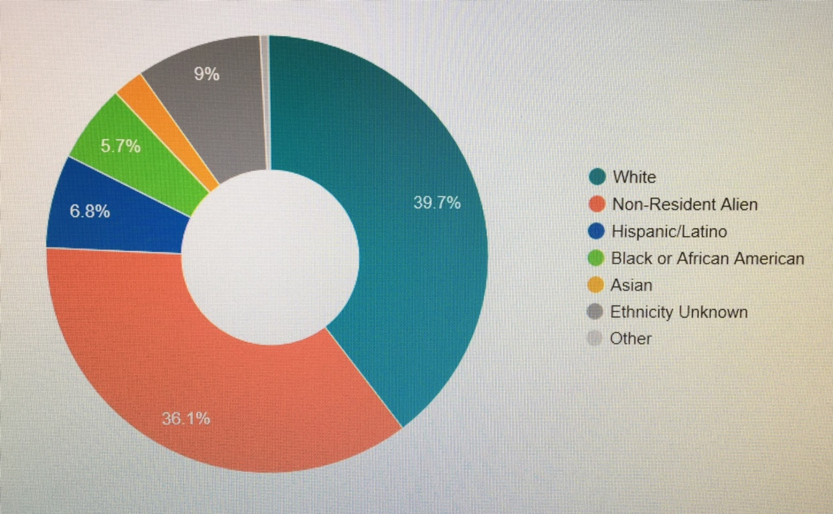
#1 – No main Writing Center / ESL
The Writers’ Den is the place to come for writing. Students meet to improve their writing with the guidance of tutors and a faculty member.
brainstorming writing topics
focusing ideas
revising papers
peer editing
polishing prose
overcoming obstacles
sharing success

Slide 7
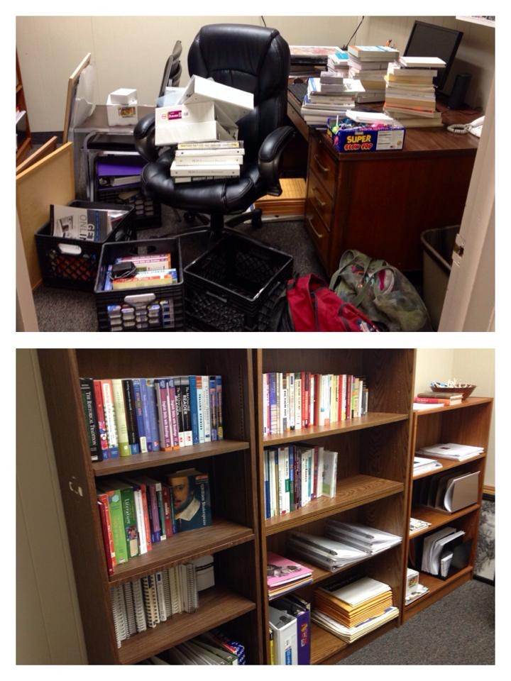
#2 – No physical space
A library bench does not cut it.
Students discuss sensitive topics.
Tutors need a quiet locale.
Master keys can be made.
The schedule is on the door.
It should look inviting / include technology.

Slide 8
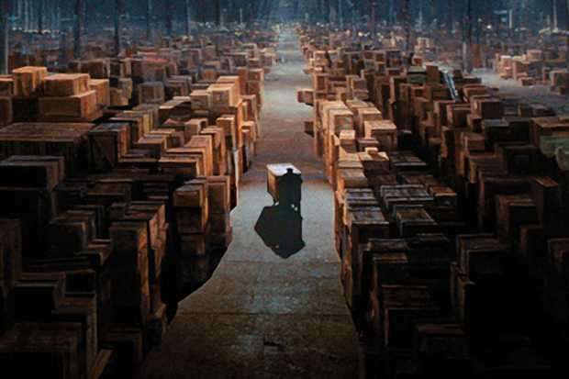
#3 – Limited funding
Never ask for money via e-mail. Go in as a group.
Power in numbers.
Look for in-house grants, even if they are $1,000.
Find the grant person on your campus. Befriend him/her.
Locate the warehouse. (You’re welcome.)

Slide 9
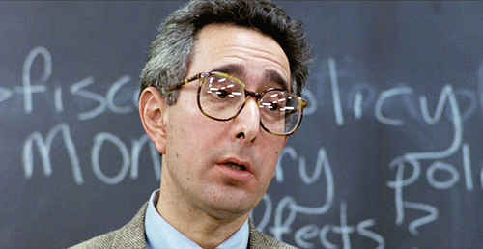
#4 – Volunteers: Anyone? Anyone?
We cannot pay faculty (office hours / service unit).
Utilize work study students (ten hours).
Graduate students enjoy the solitude.
Recruit A/B students in the classroom.
(It is easier said than done.)

Slide 10
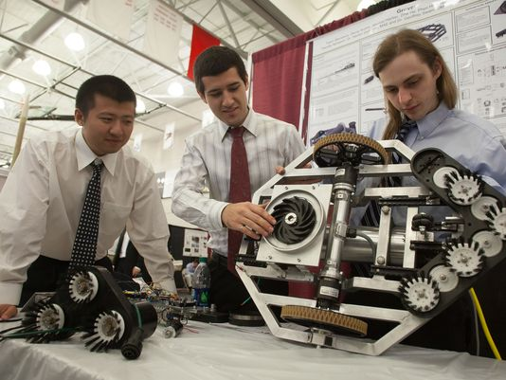
#5 – Trying to make everyone happy
Engineering
Plagiarism
Citations (handouts)
Lab reports (concise language)
Advanced technical writing skills
Get in. Get out. Get to the point.

Slide 11
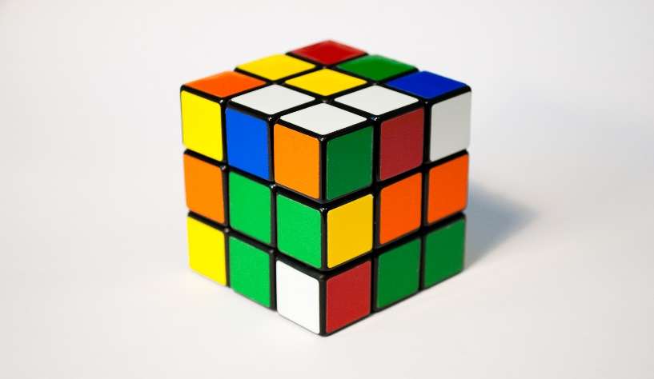
#5.1 – Trying to make everyone happy
Humanities
Verb tenses
Flow (readability / creativity)
Exposure (old / new voices)
More variety (less rocket propulsion)
Put more of yourself into your work.

Slide 12
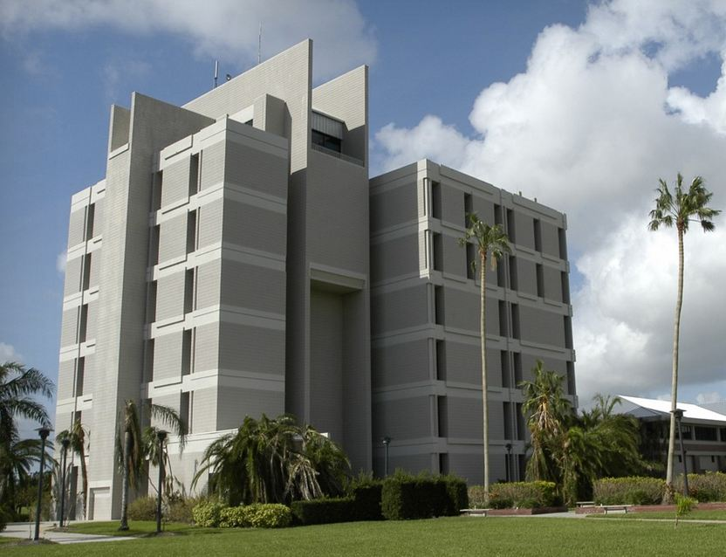
Conclusion
It’s hard to start from nothing, but you get to make the rules.
Face-to-face meetings are key.
Utilize coworkers (grants and furniture).
Appreciate the help.
Likewise, don’t overwhelm them.
Have realistic goals. And fun.

Slide 13
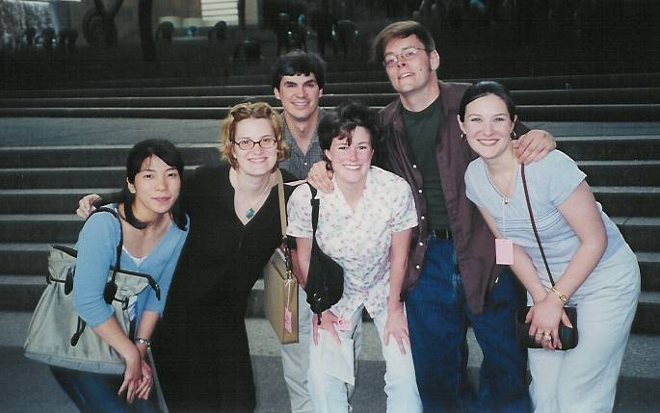
Thank you. Questions?

Slide 14
Works Cited
“Rankings & Accolades.” Florida Institute of Technology, 2017, http://web2.fit.edu/about/rankings-accolades.php Accessed 7 November 2017.

