Slide 1
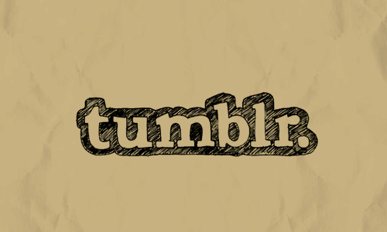

Tumblarian 101
for and Librarians
an ALA Conversation Starter
with
Rachel Fershleiser, Tumblr | @rachelfersh
Molly McArdle, Library Journal | @mollitudo
Erin Shea, Darien Library | @erintheshea
Kate Tkacik, Bank of Montreal Library | @lifegdlibrarian
Tweet and Tumbl this Conversation Starter! Use the hashtag #TumblrALA.

Slide 2
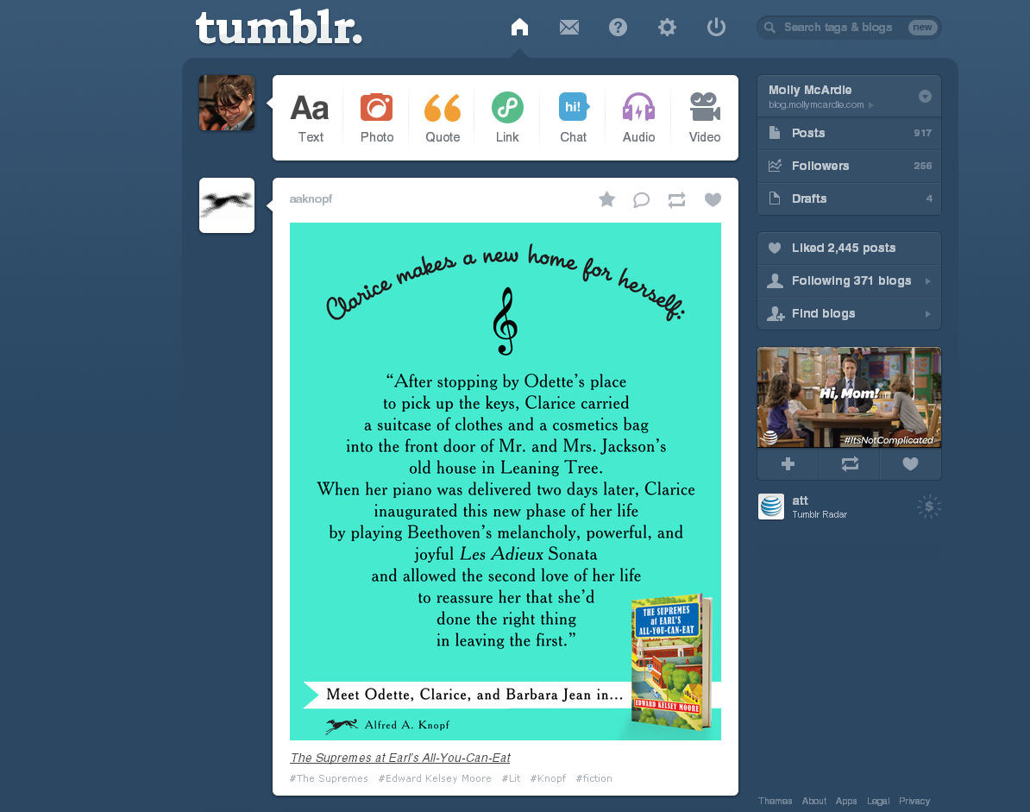
This is a
dashboard.
#TumblrALA

Slide 3
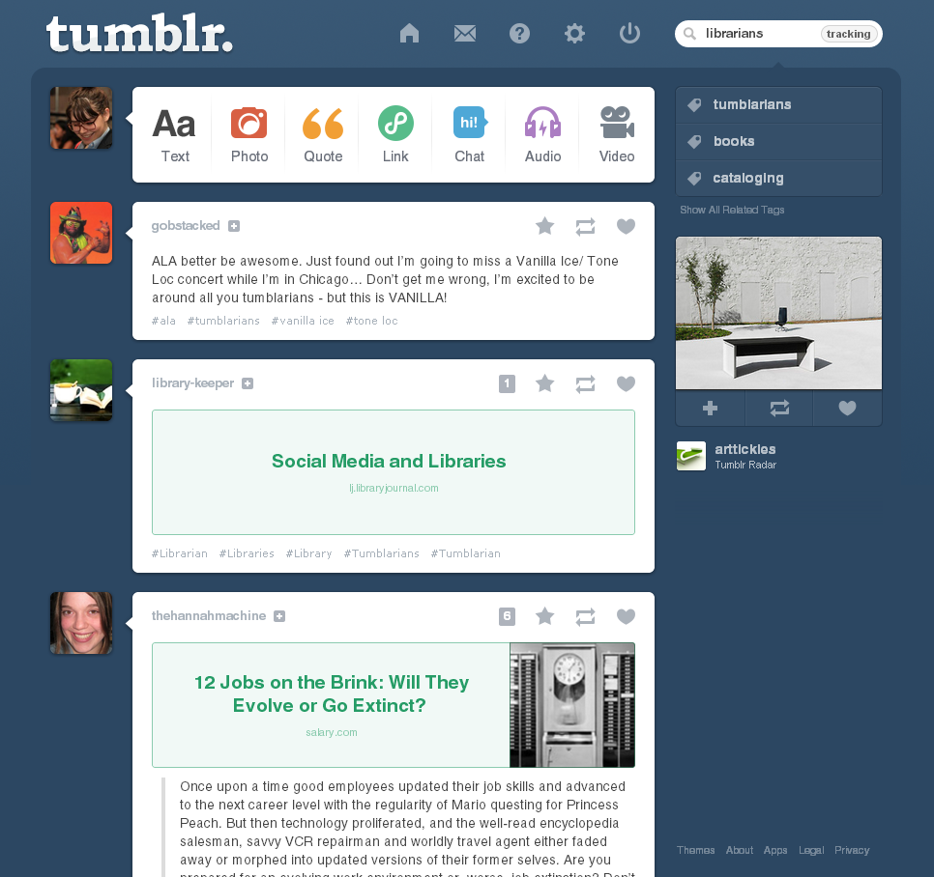
This is a
tracked tag.
#TumblrALA

Slide 4
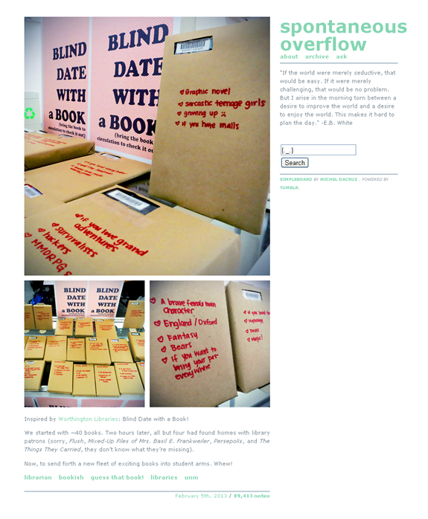
Silvia is a librarian at the University of New Mexico in Albuquerque, NM. This is her personal Tumblr. (alethiosaur.tumblr.com)
#TumblrALA

Slide 5
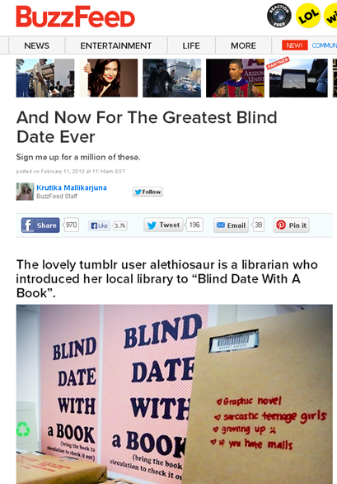
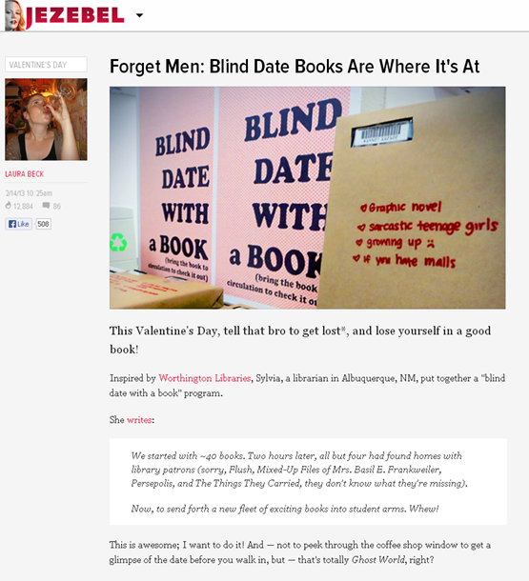
Her post got noticed:
#TumblrALA

Slide 6
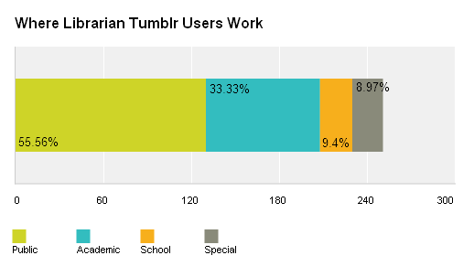
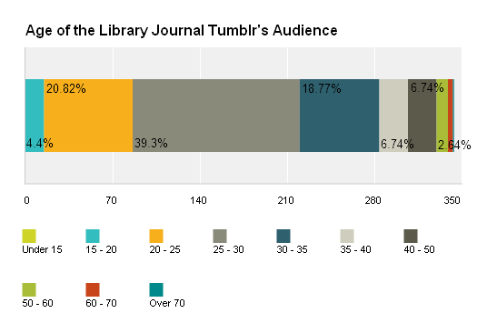
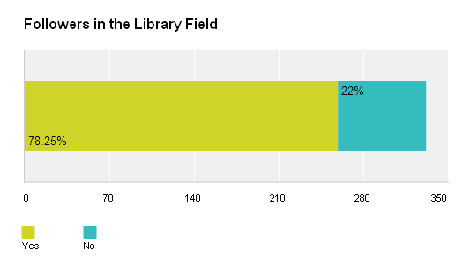
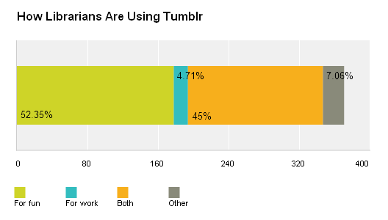
Some stats:
#TumblrALA

Slide 7
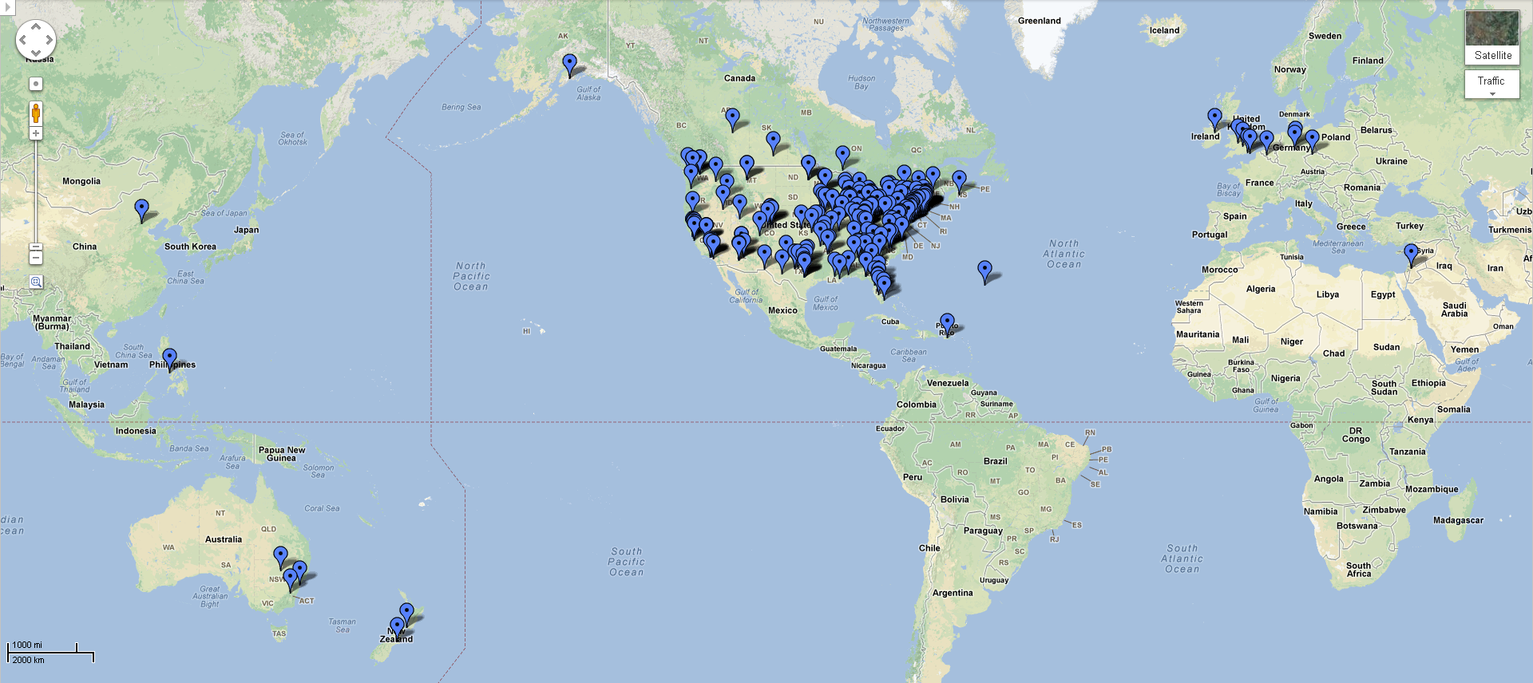
Where Library Journal Tumblr readers are located:
#TumblrALA

Slide 8
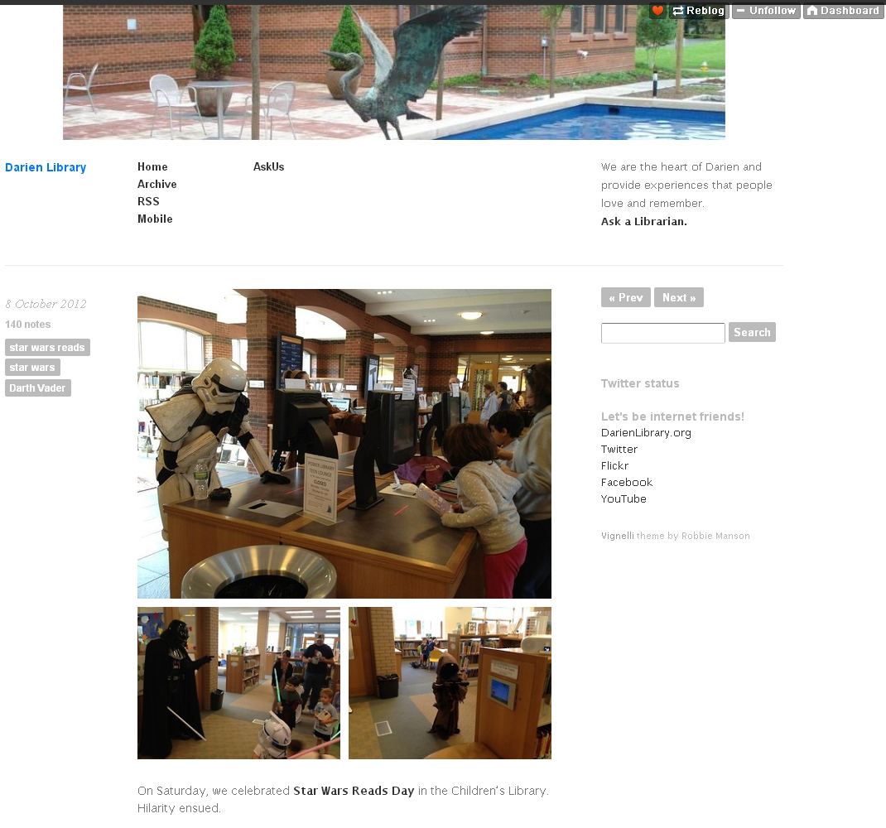
#TumblrALA

Slide 9
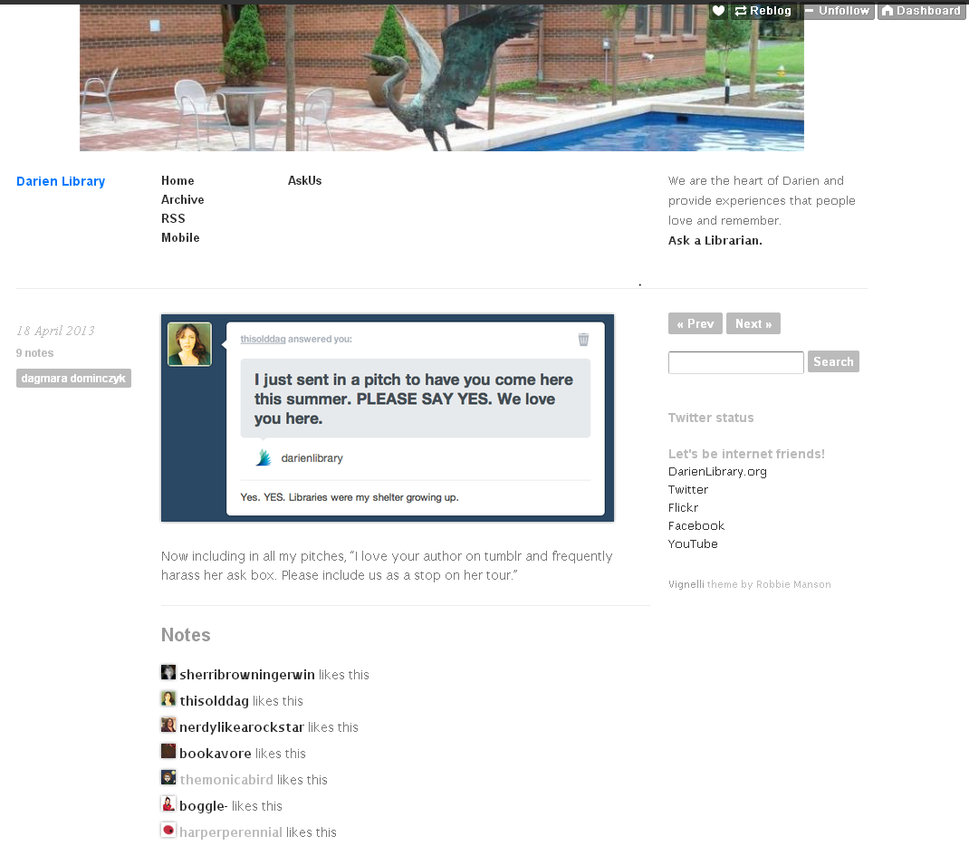
#TumblrALA

Slide 10
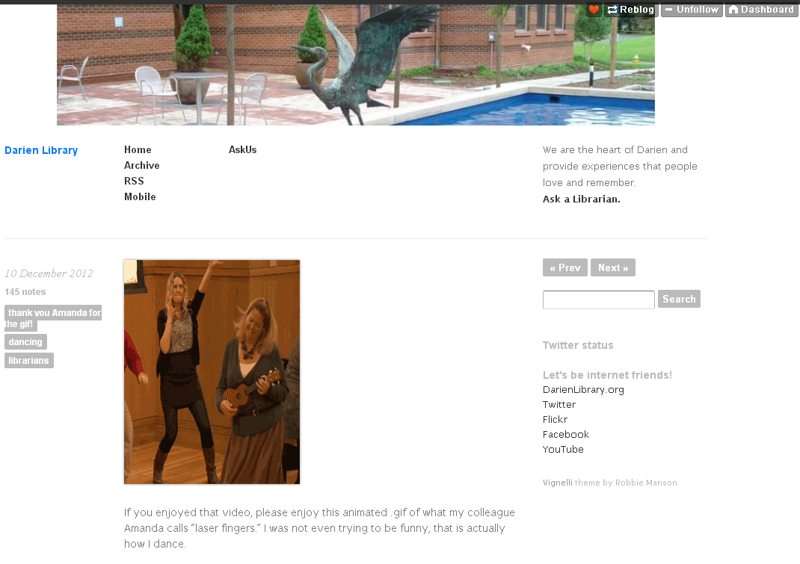
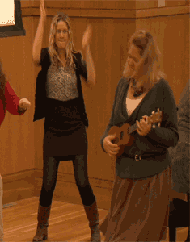
#TumblrALA / #laserfingers

Slide 11
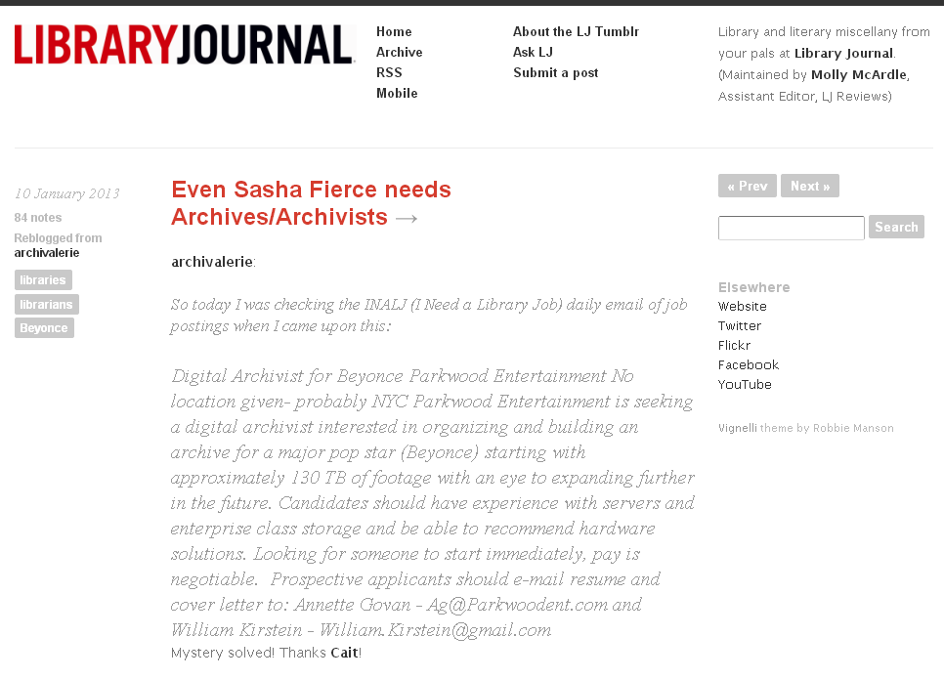
#TumblrALA

Slide 12
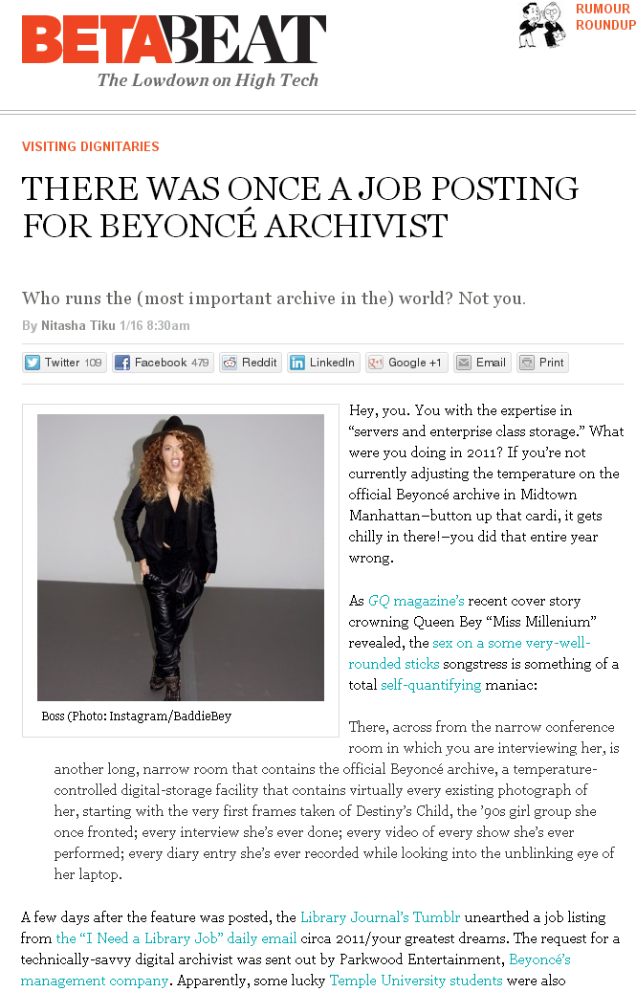
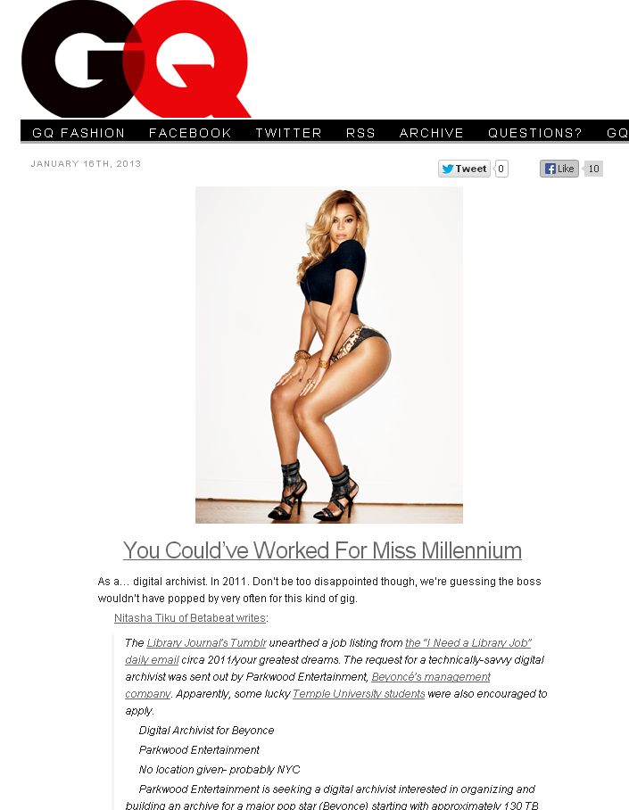
#TumblrALA

Slide 13
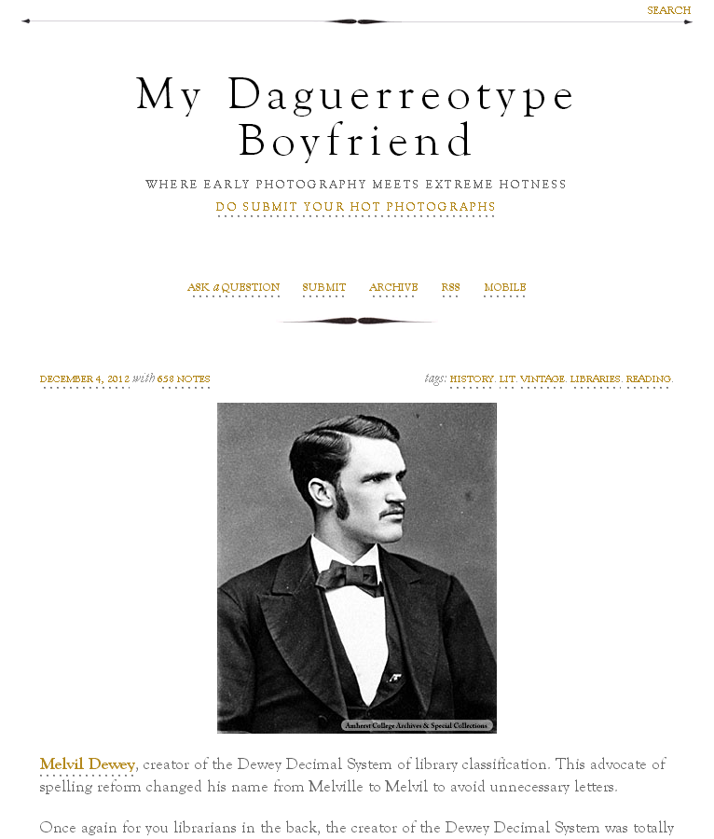
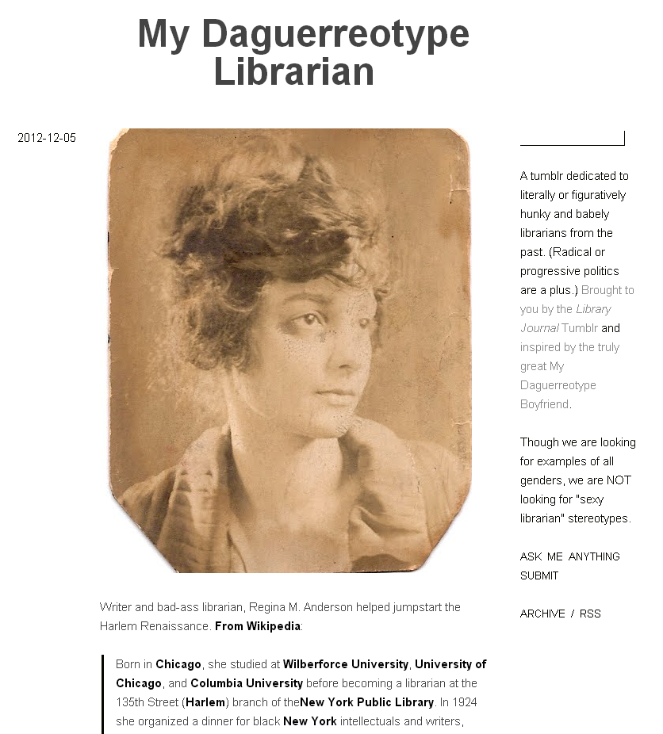
#TumblrALA

Slide 14
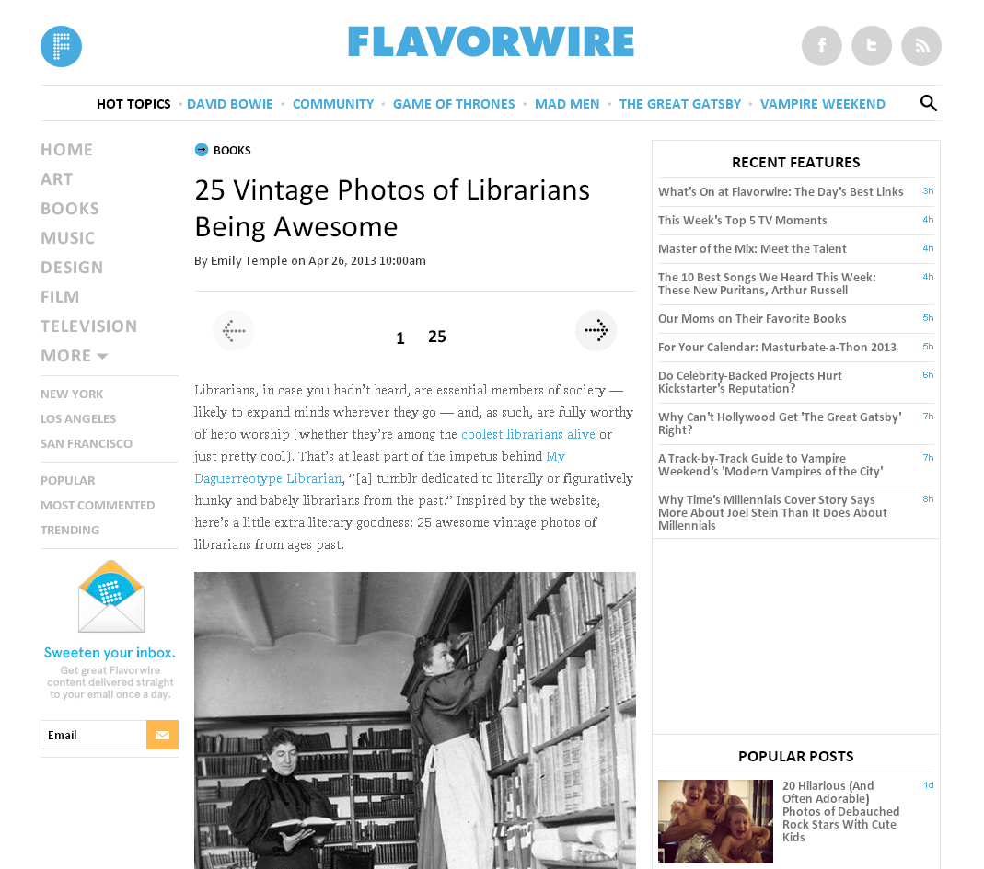
#TumblrALA

Slide 15
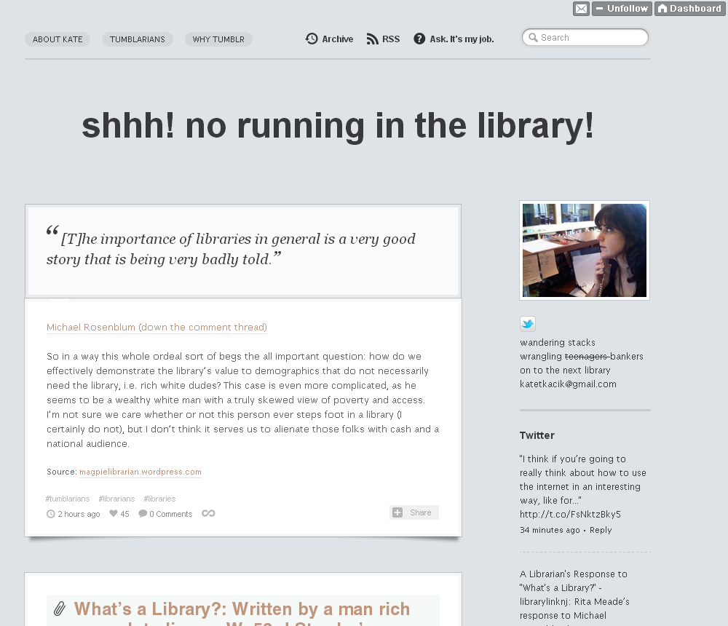
#TumblrALA

Slide 16
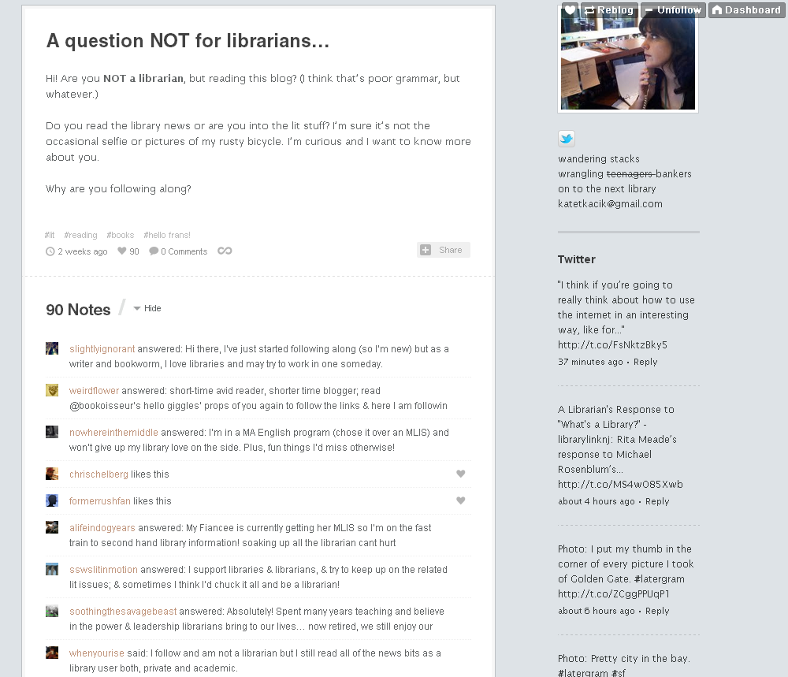
#TumblrALA

Slide 17
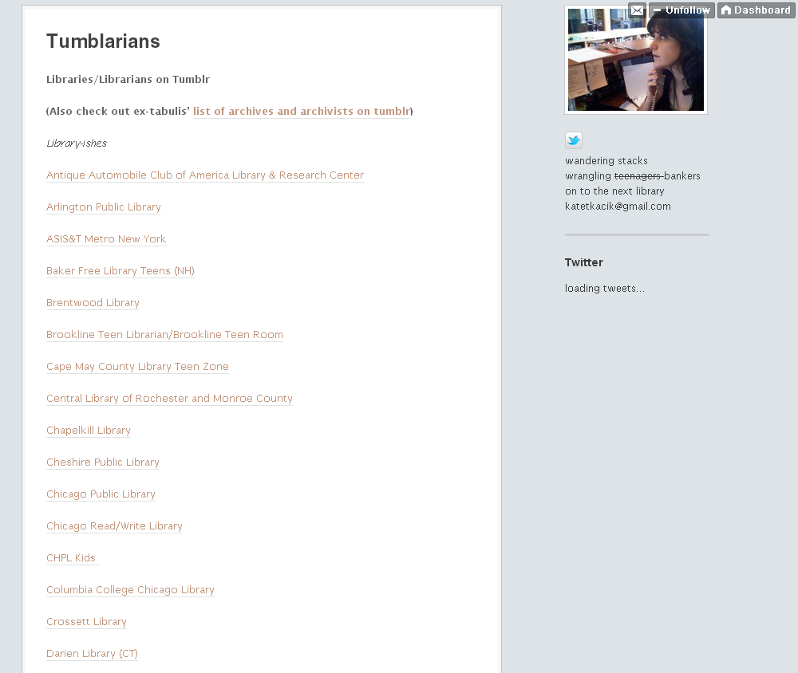
#TumblrALA

Slide 18
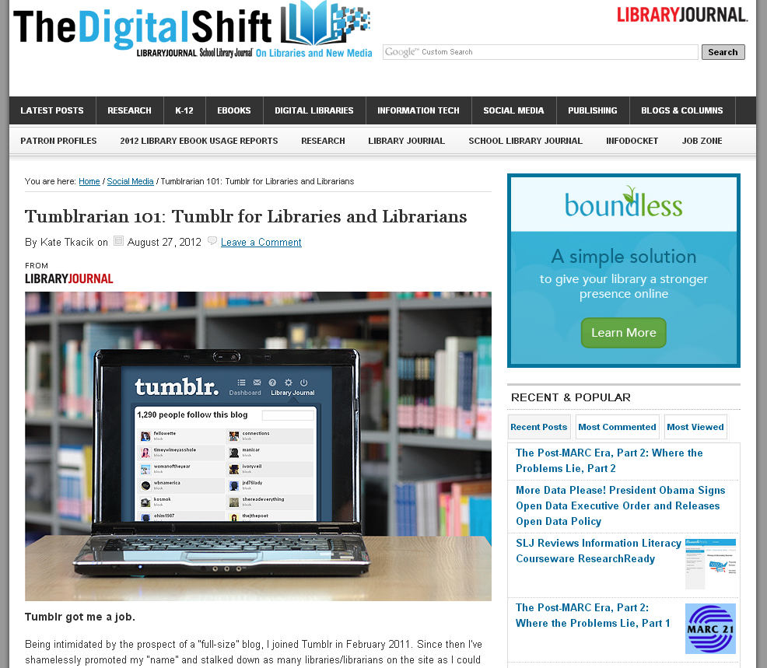
#TumblrALA

Slide 19
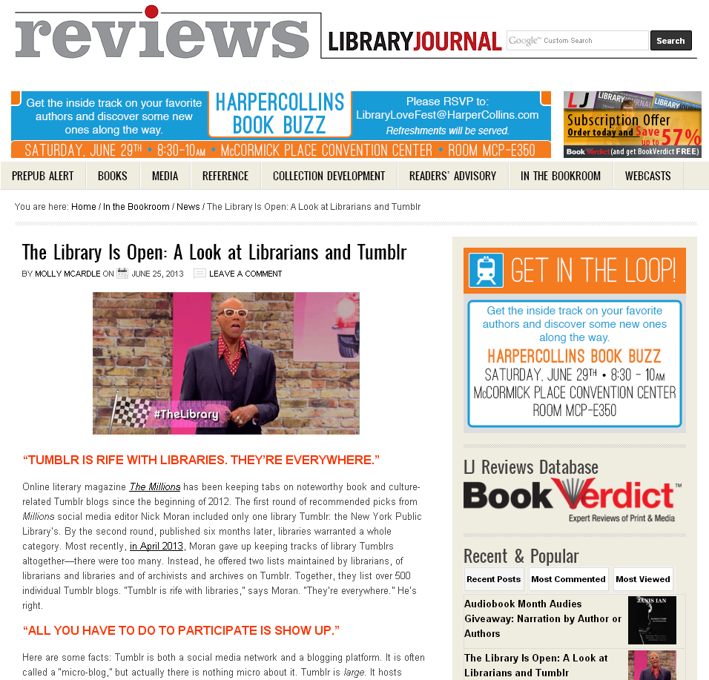
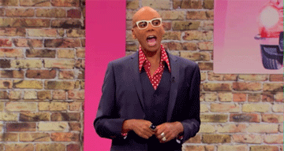
#TumblrALA

Slide 20
Contact Us!
Rachel Fershleisher
rachelf@tumblr.com | rachelfershleiser.com
@rachelfersh
Molly McArdle
mmcardle@mediasourceinc.com | tumblr.libraryjournal.com
@mollitudo
Erin Shea
eshea@darienlibrary.org | darienlibrary.tumblr.com
@erintheshea
Kate Tkacik
katelyn.tkacik@bmo.com | thelifeguardlibrarian.tumblr.com
@lifegdlibrarian
#TumblrALA

