Slide 1

The Myth and Reality of the Evolving Patron(s)
Lee Rainie (@lrainie)
Director
Pew Research Internet Project
#rusapres13
Notes:
Just how well do you know the people who use your library? Lee Rainie, Director of the Pew Research Center’s Internet & American Life Project and co-author of Networked: The New Social Operating System, shares the latest data about how our clientele are interacting with information technology. Learn about patron preferences and behaviors during this program. Then, join Mr. Rainie and library leaders on Sunday, 10:30-11:30 am, to discuss how the data may influence your library’s future.
Speaker: Lee Rainie, Director, Pew Research Center’s Internet & American Life Project
Session URL: http://ala13.ala.org/node/10227
The Myth and the Reality of the Evolving Patron: The RUSA President’s Program with Lee Rainie
WHEN:
Saturday, June 29, 2013 - 4:00pm to 5:30pm
LOCATION:
McCormick Place Convention Center
S105a-c
PRESENTERS:
Speaker: Lee Rainie, Director, Pew Research Center's Internet & American Life Project
DESCRIPTION:
Just how well do you know the people who use your library? Lee Rainie, Director of the Pew Research Center's Internet & American Life Project and co-author of Networked: The New Social Operating System, shares the latest data about how our clientele are interacting with information technology. Learn about patron preferences and behaviors during this program. Then, join Mr. Rainie and library leaders on Sunday, 10:30-11:30 am, to discuss how the data may influence your library's future.
Add the Sunday follow-up discussion** to your schedule:
http://ala13.ala.org/node/11269
**Selected as a "top pick" event by Library Journal!
HASHTAG:
#rusapres13
MEETING TYPE:
Presidents program
Speaker series
Program

Slide 2

“Tell the truth, and trust the people”
-- Joseph N. Pew, Jr.
http://bit.ly/dUvWe3
http://bit.ly/100qMub

Slide 3
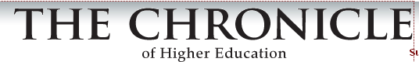
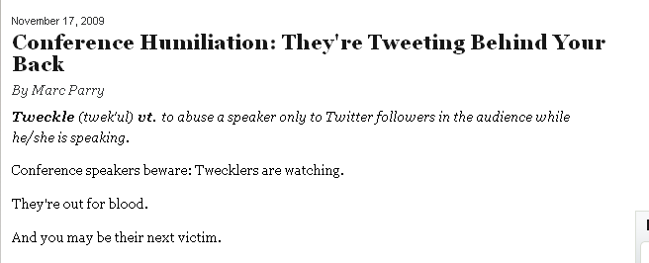
“Tweckle (twek’ul) vt. To abuse a speaker to Twitter followers in the audience while he/she is speaking.”

Slide 4
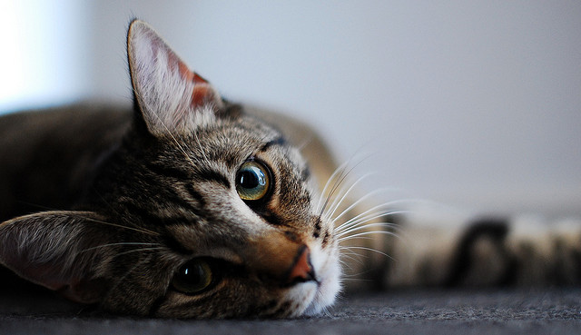
we need a tshirt, "I survived the keynote disaster of 09"
it's awesome in the "I don't want to turn away from the accident because I might see a severed head" way
too bad they took my utensils away w/ my plate. I could have jammed the butter knife into my temple.
http://bit.ly/124U9a4
Notes:
http://www.free-picture.net/animals/cats/bored-cat.jpg.html

Slide 5
Tech revolution has changed patron experiences and expectations in 5 ways
Evolution driven by purpose of engagement/need
Evolution driven by life stage
Evolution driven by life stressors (time demands, urgency)
Evolution driven by demographics
Evolution driven by library innovation (supply side evolution)

Slide 6
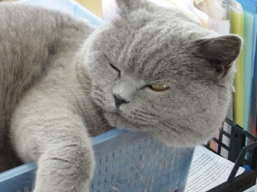
Shaped by inertia as well as innovation http://bit.ly/14x7IlG
Notes:
http://oldladylaughing.blogspot.com/2013/01/yet-another-poem-about-dead-cat.html

Slide 7
Current state of play – patrons
 |  | % who have visited a library or bookmobile in person in the past year
All Americans ages 16+ |  | 53%
a | Men (n=1,059) | 48%
b | Women (n=1,193) | 59ª
Age
a | 16-17 (n=101) | 62%^{de}
b | 18-29 (n=369) | 57%^{e}
c | 30-49 (n=586) | 59%^{de}
d | 50-64 (n=628) | 51%^{e}
e | 65+ (n=531) | 40%
Education attainment
a | No high school diploma (n=254) | 43%
b | High school grad (n=610) | 46%
c | Some College (n=562) | 58%^{ab}
d | College + (n=812) | 63%^{ab}
Parent of minor
a | Parent (n=584) | 64%^{b}
b | Non-parent (n=1,667) | 49%
53%
59%
40%
58%
63%
64%

Slide 8
Current state of play – activities
Women / parents
Afr-Amer / >50 / poorer
Minorities / age 16-29 poorer
Parents
Women

Slide 9
Current state of play – website users
 |  | % who have ever visited a library website
All Americans ages 16+ |  | 39%
 | Men (n=1,059) | 33
 | Women (n=1,193) | 44ª
Age
 | 16-17 (n=101) | 47de
 | 18-29 (n=369) | 48de
 | 30-49 (n=586) | 47de
 | 50-64 (n=628) | 32e
 | 65+ (n=531) | 19
Household income
 | Less than $30,000/yr (n=629) | 30
 | $30,000-$49,999 (n=363) | 37ª
 | $50,000-$74,999 (n=314) | 44ª
 | $75,000+ (n=567) | 52^{abc}
Education attainment
 | No high school diploma (n=254) | 24
 | High school grad (n=610) | 22
 | Some College (n=562) | 44^{ab}
 | College + (n=812) | 60^{abc}
Parent of minor
 | Parent (n=584) | 46^{b}
 | Non-parent (n=1,667) | 36
39%
44%
19%
52%
60%
46%

Slide 10
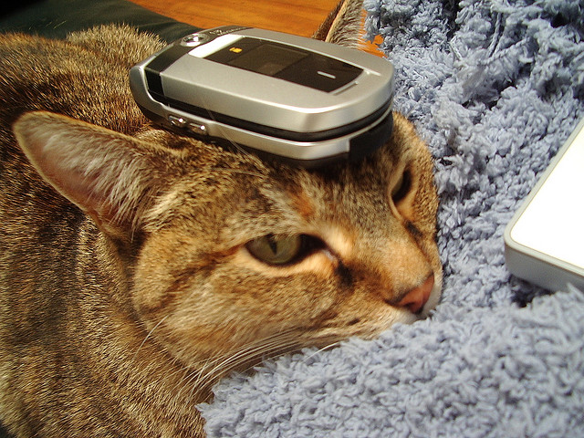
Current state of play – Mobile connectors
13% of those 16+
  Those under 50
  Those with college degrees
  Those in non-rural areas
Flickr - http://bit.ly/18iUyhF
Notes:
http://www.flickr.com/photos/themaninblue/538623646/sizes/z/in/photolist-PAA3A-TrX9K-YenHk-2aqT5A-2kduAe-2pAP62-2ykixx-2z8Who-342jJQ-3Ek5dt-3TxPc8-4bMuUY-4capxP-4irQwz-4ofef7-4rwFuX-4rALgf-4rALpm-4uQua4-4uQwyF-4uQxqM-4uUB3C-4x92NZ-4yR7SR-4Ck388-4CPDUB-4EhVPF-4FhkTD-4Fmz85-4Fmz9L-4Fmzhf-4FVRzN-4JbHQP-4JbJQR-4JfXAh-4JfYt7-4LkFxt-4LpWrL-4Lq19A-4Lq6TY-4SkjAH-4UPv7H-4UTHvu-4VaV1p-4ZhbpW-5gXk71-5k1DqY-5kLuXd-5mw8Zd-5mMBPJ-5pswmt/

Slide 11
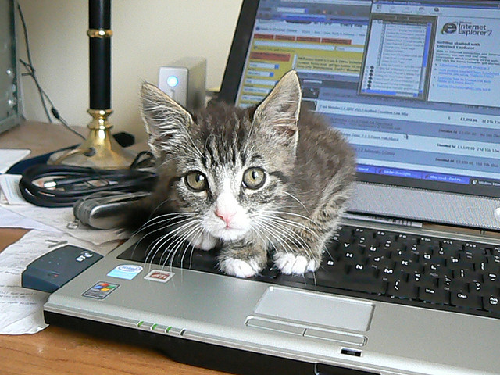
Three tech revolutions and their impact on patrons and libraries
Flickr – dougwoods
http://bit.ly/12vpOBy
Notes:
http://bit.ly/12vpOBy

Slide 12
Revolution 1
Broadband (68%)/ Internet (85%)
3%

Slide 13
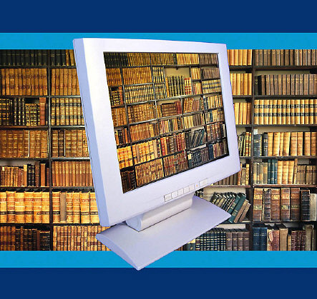
Impact on patrons and libraries
Collections moved from atoms to bits
More volume, velocity, and variety of information
Rise of “fifth estate” of civic and community actors
More arguments in the culture – libraries function as “commons” and “referees”

Slide 14
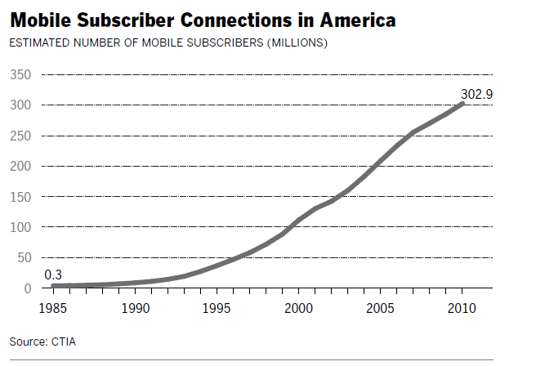
Revolution 2
Mobile – 91% … smartphone 56% … tablets 34%
326.4
Total U.S. population:
319 million
2012

Slide 15
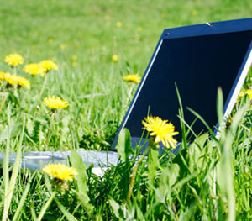
Impact on patrons and librarians
Attention zones change
  “Continuous partial attention”
  Deep dives
  Info snacking
Real-time, just-in-time searches
Augmented reality highlights the merger of data world and real world

Slide 16
Revolution 3
Social networking – 61% of all adults
72% of internet users

Slide 17
State of social media
 | % of internet users who…. | The service is especially appealing to …
Use Any SNS | 72% | Adults ages 18-29, women
Use Facebook | 68 | Women, adults ages 18-29
Use Twitter | 18 | Adults ages 18-29, African-Americans, urban residents
Use Pinterest | 15 | Women, adults under 50, whites, those with some college education
Use Instagram | 13 | Adults ages 18-29, African-Americans, Latinos, women, urban residents
Use Tumblr | 6 | Adults ages 18-29

Slide 18
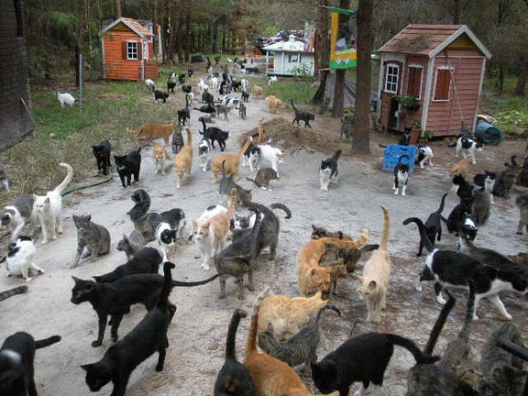
Impact on patrons and librarians
Composition and character of people’s social networks changes AND networks become important channels of …
  learning
  trust
  influence
Context of expertise expanded to “amateurs”
Organizations can become “helper nodes” in people’s networks
Notes:
Attention – act as sentries
alerts, social media interventions, pathways through new influencers
Assessment – act as trusted, wise companion
help assess the accuracy of info, timeliness of info, transparency and rigor of info
Action – act as helpful producers/enablers
help give people outlets for expression, interpretation of their creations

Slide 19
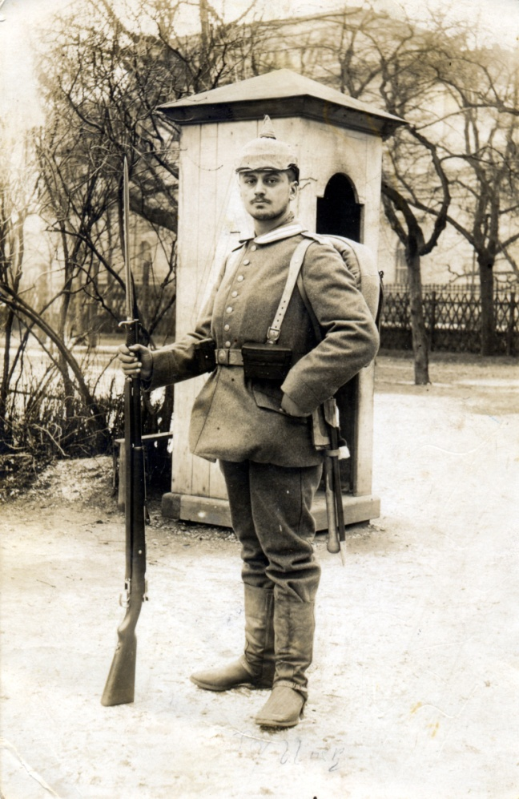
Social networks act as …
sentries

Slide 20
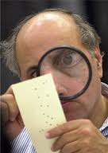
Social networks act as …
evaluators

Slide 21
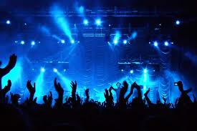
Social networks act as …
audience
new media are the new neighborhood

Slide 22
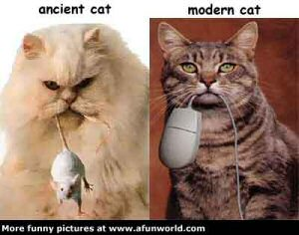
Back to the 5 evolutions
Notes:
http://www.nevon.net/nevon/2005/01/the_evolution_o.html

Slide 23
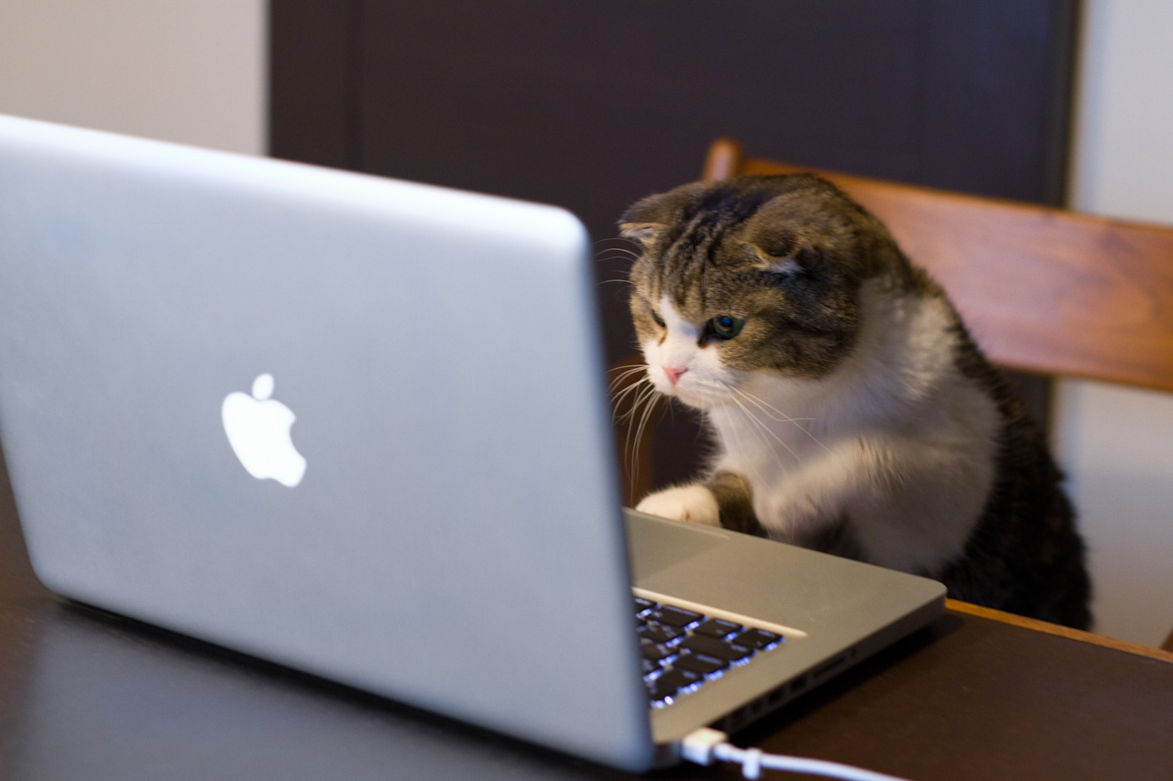
1 – Patron evolution driven by purpose of engagement/need
Searching
Learning
Browsing Discovering
Soliciting expertise Acting on impulse

Slide 24
1 – Patron evolution driven by purpose of engagement/need
Self-directed
Easier
Omnipresent
Facilitated by personal networks and crowds

Slide 25
1 – Patron evolution driven by purpose of engagement/need
More noise
More junk
More temptations
More distractions

Slide 26
Librarian takeaways
Networks matter
Tech mastery matters
Lifelong learning is
the norm
New divides emerge New ethics = important

Slide 27
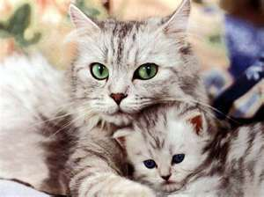
2 – Patron evolution tied to life stage
Students
Young workers
30somethings
40-50somethings
Younger retirees
Older retirees
Notes:
http://

Slide 28
2 – Patron evolution tied to life stage
Overlaid with current life stage differences in technology adoption and use
Notes:
http://

Slide 29
2 – Patron evolution tied to life stage
Librarian takeaways
This is familiar territory
Driver of the demands that you be “everything to everyone”
People’s needs change and you have opportunities to be newly relevant to them
Notes:
http://

Slide 30
2 – Patron evolution tied to life stage
Librarian takeaways
Generational differences can be bridged by connecting to the non-user via the non-user
Only 22% say that they know all or most of the services their libraries offer
Notes:
http://

Slide 31
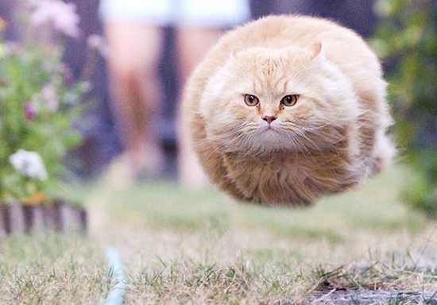
3 - Patron evolution driven by life stressors
http://bit.ly/12vNSUT

Slide 32
Inversion of scarcity and abundance

Slide 33
Librarian takeaways
Time is of the essence.
You are in the experiential goods business (“If I spend my time with you, I want it to be special”).

Slide 34
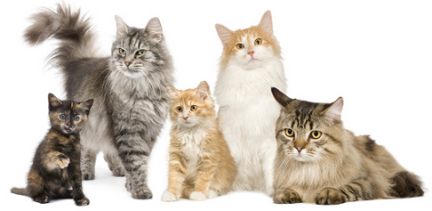
4 - Patron evolution driven by demographics
Notes:
http://www.cat-breed-info.com/

Slide 37
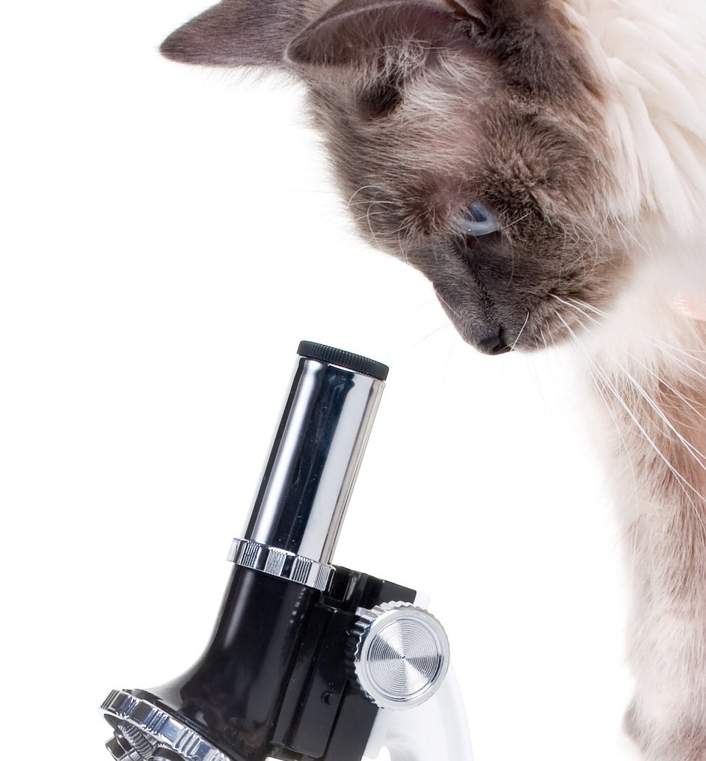
5 - Patron evolution driven by library innovation
Notes:
http://bpvets.net/blog/?page_id=653
App -- German Traces NYC, Goethe-Institut New York Library with Pratt Institute School of Information and Library Science, New York City
The Library as Incubator Project hosts and celebrates libraries and artists around the country
San Francisco – naturalization help and tax preparation help
Nursing and Medical Services Pima County Public Library, Tucson, Ariz.
And get vital signs measured at the Topeka Library
Musical instrument check out program – Lopez Island Washington
Lend telescopes and get lessons at Portland …. Check out fishing tackle in Kenai, Alaska
Downloadable E-book App - Cuyahoga County Public Library, Parma, Ohio
LibraryFarm – Onondaga, NY
Right Service at the Right Time App for help discovering and getting government services in Orlando, FLA
Snap & Go Contra Costa County (Calif.) Library – QR codes; text a librarian
Gimme Engine Scottsdale (Ariz.) Public Library for book recommendations
Also in Tuscon -- Story Town: Live stage shows of favorite children’s books.
The Library as Incubator Project hosts and celebrates libraries and artists around the country
Downloadable E-book App - Cuyahoga County Public Library, Parma, Ohio
A librarian in the home – rural elderly, Ft. Collins, CO
Silent film accompanied by piano – Darien Connecticut
Zombie Survival Training for Teens – Marshall County, Kentucky
A lot of just good blocking and tackling
Harry Potter Parties / Read to a dog / therapy dogs / Beanie Baby reading / haunted history tours / stuffed animal sleepover / yoga classes and aerobics for seniors / teen battle of the bands / gaming nights / comics conventions /star wars parties / crafting guilds as fundraisers to build deeper ties to communities / cooking classes / soap making classes / how-to festivals / library-oke (karaoke at library) / wine tastings
Now famous hog butchering demonstrations in Overland Park, Kansas
Cherry Hill, NJ Valentine's Day Shipper's Shindig – In fandoms, "shipping" is short for "relationshipping" and involves "imagining a relationship between two fictional characters from a show, movie, or book series."
Ocean County, Ready Set Date speed dating nights

Slide 38

Be not afraid

Slide 39
Libraries.pewinternet.org
Lee Rainie
Email: lrainie@pewinternet.org
Twitter: @Lrainie
Kathryn Zickuhr
Email: kzickuhr@pewinternet.org
Twitter: @kzickuhr
Kristen Purcell
Email: @kpurcell@pewinternet.org
Twitter: @kristenpurcell

