Slide 1
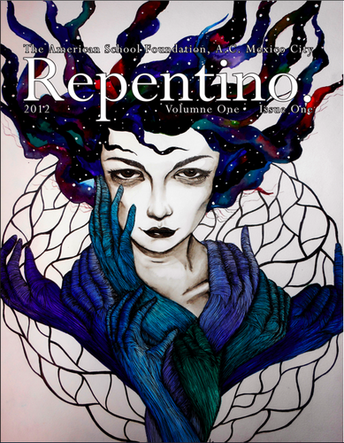
Camila de la Parra
Natalia Garcia
Sofia Israel
Alexa Ares
Ana Cristina Barajas
Natalie Cruz
Alia Suhaimi
Camille Morales
Alice Kanitz
Advisor: Harry Brake

Slide 2
What is
Repentino?

Slide 3
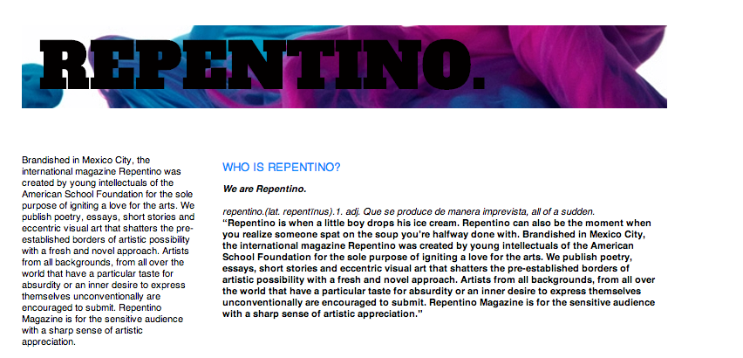

Slide 4
Repentino seeks avid lovers of life, literature and art.
Repentino seeks YOU.

Slide 5

What is
ASF?
Founded in 1888
Oldest American School in Mexico
This year, we are celebrating its 120th birthday.
International Institution
Incorporated the Mexican American School.
Offers both AP and IB programs

Slide 6
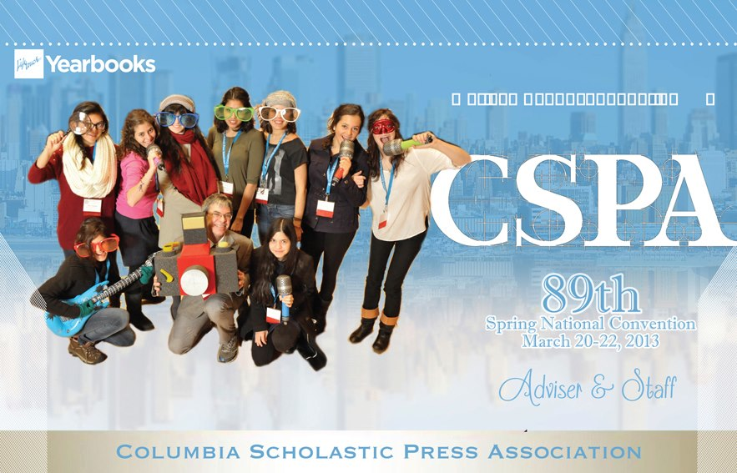
The STAFF
We come from Mexico, Argentina, Malaysia, Puerto Rico, Brazil, Spain, China, United States, and Germany.
We speak English and Spanish between most of us, but occasionally other languages may peak in.
Includes from
Freshmen (14 years old)
to Seniors(18 years old).
Our Advisor is Harry Brake
Notes:
advisor for 5 years as yearbook advisor, now Repentino. Also an
English teacher of 12 years and numerous self motivated participant of
all things charitized (lol) and interactive.

Slide 7
How does it impact
Repentino?
Known by many people from all across the globe.
Various interests and experiences.
Passion for different types of art and writing.
Therefore, we get international variety for our magazine.

Slide 8

How did Repentino start?
Before it was called Reflections
In 2011, it became Repentino.
With help from school personnel and Grupo Editorial Vid, we published Repentino Volume I

Slide 9
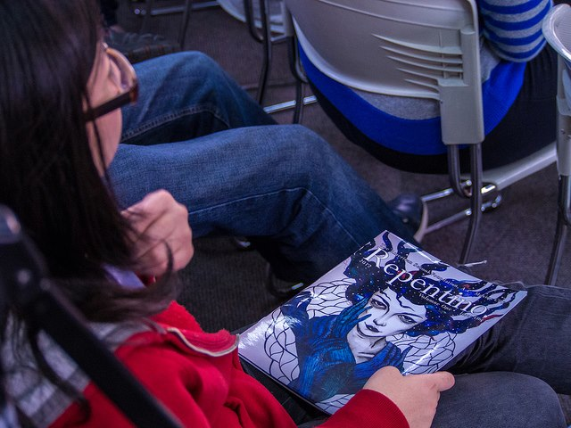
The group grew from 4 members to over 15 for the 2012-2013 school year.
Won 3rd most active club of the school.
Received Silver Medal in the critique from the CSPA.

Slide 10



Internationalism
Importance:
  Part of the ASF spirit.
  Embrace globalization.
  Give an opportunity for artists from all over.
  Expand the reader’s comfort zone.

Slide 11


Means
  Publish works from all over the world.
    Different economical possibilities.
  Portray struggles of different areas of the world and social classes.
  Need to be extremely open-minded!

Slide 12
Role of Repentino
We receive submissions from:
  Mexico
  United States
  Cambodia
  France
  Malaysia
  United Kingdom
Give chance to explain their work
Do not risk the quality standard for internationalism

Slide 13
Languages
Dealing with contrasting languages:
  Mainly English and Spanish submissions.
  Pieces in every language are welcome as long as they come with a translation.
  Encourage Spanglish.
Notes:
Understand it might not be the submitter’s first language.
Can take a lot of time on the editing.

Slide 14
How do we get submissions?
Social media (Tumblr, Twitter, Facebook)
Events such as the Club Fair and Art Fair.
Throughout the school bulletin (Publish US)
Videos and posters
Open Mic Nights

Slide 15

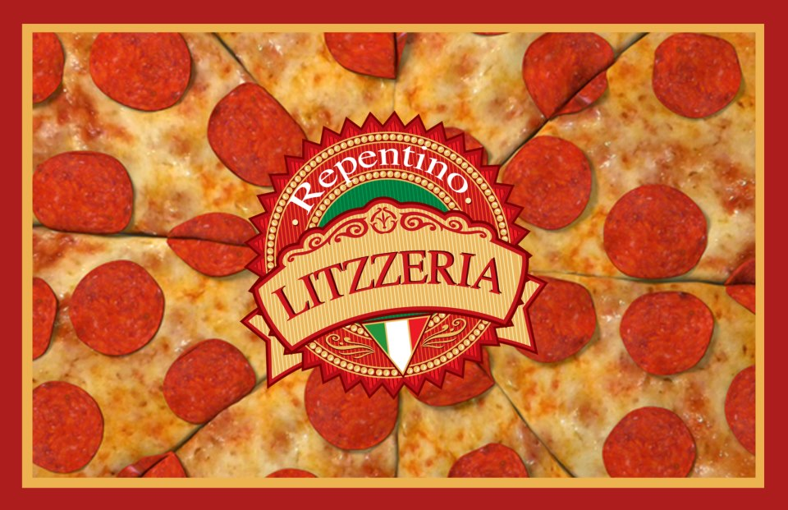






Slide 16
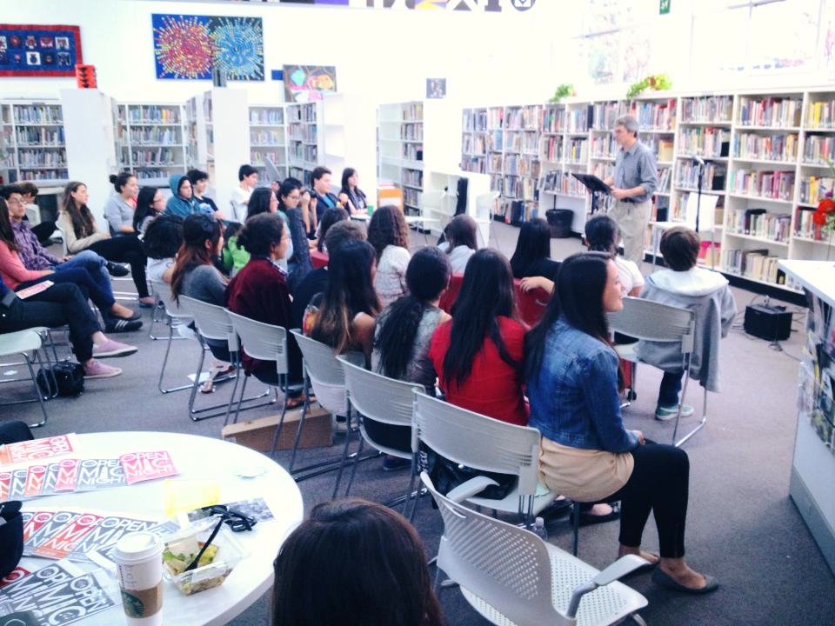
Open Mic Night
Video:
http://www.youtube.com/watch?v=ZmcUz-ZyVJ0

Slide 17
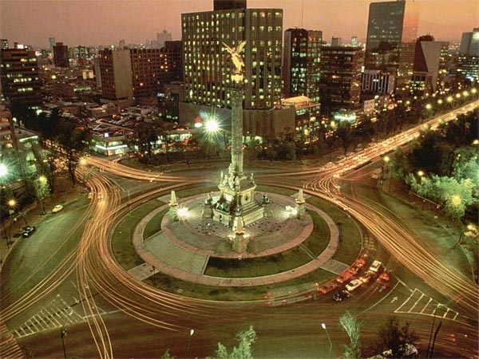


Mexico
How does living in Mexico affect our point of view?
  3rd world country
  Deep-rooted traditions that shape us as people as nation.
  Limited cultural opportunities.
  Hope to have an impact on school as well as on the outside world.

Slide 18
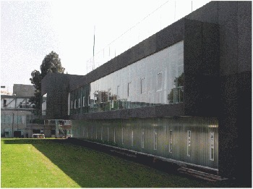

How does attending an American/International school affect our point of view?
Limited economic diversity among students.
Have access to courses that help us widen our understanding and judgment of other cultures’ art and writing.

Slide 19
Conclusion
How we expect Repentino to grow in the following years.
  Reach a wider audience.
  Have featured artists and writers.
  Form relationships with other literary and arts magazines throughout the world

Slide 20
Submissions
Web: http://repentinomagazine.tumblr.com/
Email: asflitmag@gmail.com
Notes:
Why international?
- Where do we get submissions?
- How is Western art different from non-western art?
- How do we judge the submissions?
- Sacrifice quality for more internationalism?
- How do we avoid stereotypes but embrace other cultures?
- How do we get the magazine to reach a wider audience?

