Slide 1
Creativity and
Literary Abandon
National Novel Writing Month and You

Slide 2

What does it mean to be creative?
Please take five minutes to answer this question in your journals.

Slide 3

Imagine yourself as an author…
What would your book cover look like?
Who would your fans be?

Slide 4
What is NaNoWriMo?
National Novel Writing Month between November 1st and November 30th is 30 days of literary abandon. It means setting your inner editor aside for a month and letting your imagination run free. It means pouring your voice, life, self, and perspective into a work to reflect the world you live in!
30 Days of writing toward a set word count goal.
Freedom to write about what you want within the novel genre.
The support and motivation of friends, peers, and instructors.

Slide 5
How it will work:
You will learn about a new element of novel/fiction-writing during each class period.
You may not officially start writing the novel until November 1, and must stop on November 30.
You can set your own word-count goals.
Quantity is better than quality until editing begins in December.

Slide 6
So, what is Creativity?
Share your responses.

Slide 7
How many of you…
Had trouble thinking of the right words?
Ended up erasing something because it didn’t seem good enough?
Just went with the first thing that came to mind?
Wrote what you thought I, the teacher, would want you to say?

Slide 8
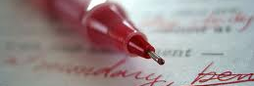
What is an Inner Editor?
What does an Inner Editor tell you?
When does an Inner Editor come in handy?

Slide 9
Usually we need our Inner Editor, but when is a time that an Inner Editor is against the rules?
Is there a time?

Slide 10
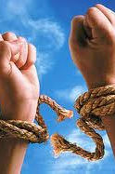
Turning Off Your
Inner Editor
This project is special because this is perhaps the only chance in our English class where creativity and experimentation are more important that grammar and technical skill.

Slide 11
How do you know your Inner Editor is taking control of you?
You are thinking for more than five minutes about what to write.
You erase more than three times.
You are bored by what you are writing.
What else lets you know?

Slide 12
Tricks to Moving Past Your Inner Editor
Taking Deep Breathes
Doing a short memory association writing
Eenie-Meanie-Miney-Mo Word Choice and Plot Turns
Look at Photos and other Images
What else?

Slide 13
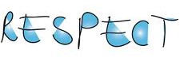
R.E.S.P.E.C.T.
Find out what it means to us…

Slide 14

Creative Spaces Require Respect
You will respect yourself and your ideas.
You will respect others and their ideas.
You will respect our space and our ideas.
We will respect each other.

