Slide 1
PTA and Our Library
How You Can Help Make a Difference

Slide 2

Role of the School Librarian
Improve students performance on state achievement test.
Enable students to develop skills to build knowledge and understanding.
Play a key role in students learning through diverse information and resources.
"You can't have good education without good libraries, and you can't have good libraries without good staff." -- ALA
Notes:
“Research has shown that the presence of a certified librarian results in students' better performance on state achievement measures (Todd, School 7). “
They also help them to develop the necessary skills they need to use information meaningfully and to build knowledge and understanding in all content areas (Todd, School 7).
The role school librarians play is crucial to students learning and teaching them how to find and use information with a variety of resources (Todd, School 7).

Slide 3
PTA
We are asking for a $800 donation to update our library's resources.
With your help we will be able to purchase new books and media.
Updated resources will better meet the needs of our students.
YOUR SUPPORT MATTERS
Notes:
We are asking for your support in donating $800 to help us upgrade our libraries resources. Our library currently has many out dated materials in the Poetry section and with your help we can purchase new titles and differing formats.
“Libraries must purchase a sufficient number of new books per student, and they must make a concentrated effort to replace older materials for each classroom and school library on an annual basis (Scholastic 7).”
“A wide variety of books and other media will appeal to the new generation of students who are born into the digital era and will encourage more reading and learning. (Harvey 28).”

Slide 4

Collections Current Status
The median age of the books & videos in the collection is 1998. (out dated material)
302 Poetry titles in current collection
3 Poetry audio-visuals
Notes:
Poetry collection is in need of current (up to date) poetry materials.
* Add: books, audio-visuals, magazines, and databases
* Materials will be aligned with, but not limited to current curriculum and state standards.
* Teacher recommendations

Slide 5
Standards and Guidelines
CCSS.ELA-Literacy.RL.1.10 With prompting and support, read prose and poetry of appropriate complexity.
CCSS.ELA-Literacy.RL.2.4 Describe how words and phrases (e.g., regular beats, alliteration, rhymes, repeated lines) supply rhythm and meaning in a story, poem, or song.
CCSS.ELA-Literacy.RL.3.5 Refer to parts of stories, dramas, and poems when writing or speaking about a text, using terms such as chapter, scene, and stanza; describe how each successive part builds on earlier sections.
CCSS.ELA-Literacy.RL.4.5 Explain major differences between poems, drama, and prose, and refer to the structural elements of poems (e.g., verse, rhythm, meter) and drama (e.g., casts of characters, settings, descriptions, dialogue, stage directions) when writing or speaking about a text.
Notes:
All of the standards(First grade – Fourth grade) presented on this slide were taken from: www.corestandards.org
(Common Core State Standards Initiative)
By the end of each school year, students are expected to master these specific standards.
* First Grade: Students will be able to read poems with little assistance.
* Second Grade: Students will be able to add meaning to what they have read.
* Third Grade: Students will be able to incorporate specific literary terms when writing. While doing this they will be able to explain why the various
parts/sections help add depth to the previous parts/sections.
* Fourth Grade: Students will be able to explain the structural elements of poems when writing or explaining the specific text.
*In order to achieve these standards, the media center must be able to offer the students up to date material which would lead to greater student achievement.

Slide 6
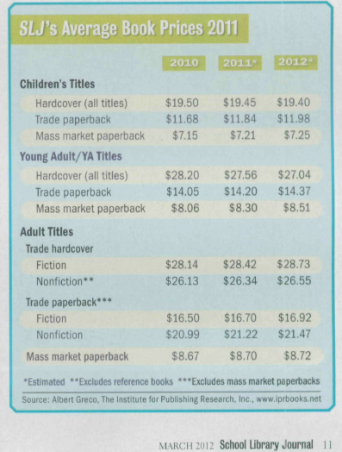
Cost of Materials
Instructors were asked regarding their curriculum needs and submitted requests for 41 resource needs that coincide with their curriculum and poetry.
According to the 2012 School Library Journal’s average book/resource prices, 27 hardcover texts would cost $523.00, four trade paperbacks would be $47.92, before the addition of Media resources such as Ebooks, Audio books, and cross-curricular web sites that synthesize the instruction together.
Notes:
This year 39 total resources, (31 books (27 hardcover, 4 paperbacks), 1 Ebook, 3 DVD’s, 1 audio book, 1 annual magazine subscription, and 2 websites that encompass the content of poetry that instructors need, and will supplement student’s needs.

Slide 7


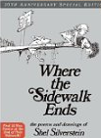
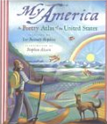

Benefits the Students
Diversity
Bilingualism
Cross-Curricular
Timeless authors
Variety of poetry forms
Rebus-style for visual recognition
Various learning styles accommodated
Flexible definitions of poetry represented
Notes:
The breadth and depth of the selections chosen, the various mediums represented, diverse content, to styles provide services to more than one skill-based student.
For example, from texts that deal with various cultures, texts that embrace the existence of Spanish to English, poetry that is in the form of an Atlas to reach into Geography,
to notable authors that withstand the aspect of time (Shel Silverstein and Dallas Clayton), the longevity of these sources is well thought out.
Additionally, in representing students with audio, visual, and contextual needs (Rebus-style poetry), the benefits to a variety of student learners is larger than a single-scoped book for a
single need, all of these texts touch upon a variety of needs (periodicals, 21st Century, visual, and kinesthetic to name a few!)

Slide 8
Works Cited
ALA. “A Message to American Library Assocition Members” Web 25 Apr. 2013.
http://www.ala.org/Template.cfm?Section=archive&template=/contentmanagement/contentdisplay.cfm&ContentID=63149
Harvey II, Carl A. "We Can Open The Window To The World." Knowledge Quest 37.5 (2009): 26-29. Academic Search Complete. Web. 25 Apr. 2013.
Miller, Rebecca T. "Fuel For Your Fire." School Library Journal 58.3 (2012): 11. Vocational and Career Collection. Web. 28 Apr. 2013.
National Governors Association Center for Best Practices, Council of Chief State School Officers. “Common Core State Standards” National Governors Association Center for Best Practices, Council of Chief State School Officers, Washington D.C. (2010). Web. 27 Apr. 2013.
Scholastic. “School Libraries Work!” Scholastic. 2008: 28p. Web. 25 Apr. 2013. http://listbuilder.scholastic.com/content/stores/LibraryStore/pages/images/SLW3.pdf
Todd, Ross J.1. "School Libraries And The Development Of Intellectual Agency: Evidence From New Jersey." School Library Research 15.(2012): 1-29. Library Literature & Information Science Full Text (H.W. Wilson). Web. 25 Apr. 2013.

Slide 9
Standard 5 – Program Management and Administration
5.4
Strategic Planning and Assessment
Notes:
In looking at this assignment, and working through this assignment, I was able to realize, a section of the school that usually comes to the various school departments, and probably not gone to enough by the individual departments that are in need. As a former public school educator, I realized the need for taking care of two things at once, and in some cases this involved instructing students how to write grants, to create funding for various projects to enhance the curriculum, to ultimately create project-based learning for the students themselves. This scenario in meeting the PTA and bringing in another investing partner to the Media Specialist realm, insures that there are many stockholders in the events and activities that are planned – and so the Media Specialist is not an island of their own. Effective data is utilized here to relay information about how the Media Center supports the school curriculum as well as the school’s mission.

